Slide 1

Online Retail II
– Sales Forecasting
Yunpeng Wang

Slide 2



Agenda
I. Introduction
II. Phase I
III. Phase II
IV. Phase III
Ⅴ. Summary

Slide 3




Introduction
online retail transaction data from UCI Machine Learning Repository

Slide 4

Time span of data set
Phase Ⅰ models:
Linear Regression;
SARIMAX
Online Retail II data set contains all the transactions occurring for a UK-based and registered, non-store online retail between 01/12/2009 and 09/12/2011.
Objective
Phase Ⅱ models:
K-means clustering
Facebook Prophet
Random Forest Regression
Perform a time series analysis and Predict the future sales data
Phase Ⅲ models:
GPT
Google Bard
XGBoost

Slide 5
Phase I
plain linear regression/ SARIMAX model

Slide 6
Data Processing
Check missing data and outliers prior to data cleaning process
Visualize time series
Data Diagnostics
Data Cleaning
Data Visualization
Unify unit of InvoiceDate
Only retain records in the UK
Delete duplicate records

Slide 7
Target Variable & Predictive Variable
Total_amount in sterling (Â£) per InvoiceDate is the target variable.
Direct Variable List:
InvoiceDate: Features of time are critical in the modeling because they capture seasonality
Derived Variable List:
const: constant dummies
lags: serial dependence
trend, trend_squared, trend_cubed: time trends
s(2,7), s(3, 7) …: weekly seasonality
sin(23,freq=A-DEC), cos(23,freq=A-DEC) …: annual seasonality
Holiday: US national holidays. The holiday has an effect on people’s purchasing patterns.
When we have design ideas, we’ll show them to you right there.

Slide 8
Pre-modeling
DeterministicProcess, CalendarFourier from statsmodels.tsa.deterministic
One-Hot encoding holiday features
Augmented Dickey-Fuller test
Data stationarity check:
Data seasonality and trend analysis
Derived variable creation
Autocorrelation
Power Spectral Density
Seasonality decomposition
Moving average

Slide 9
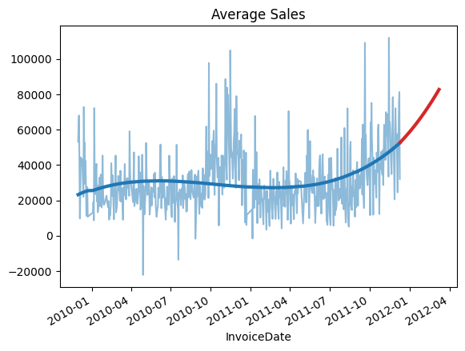
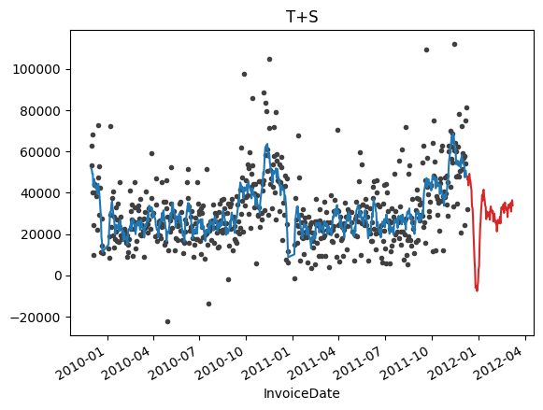
Modeling – Linear Regression

Slide 10
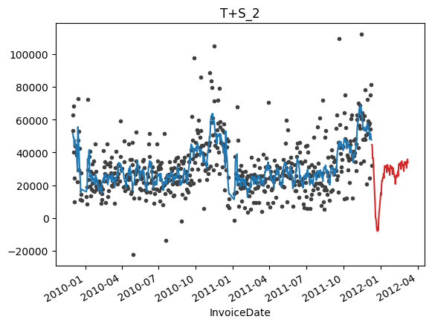
Modeling – Linear Regression

Slide 11
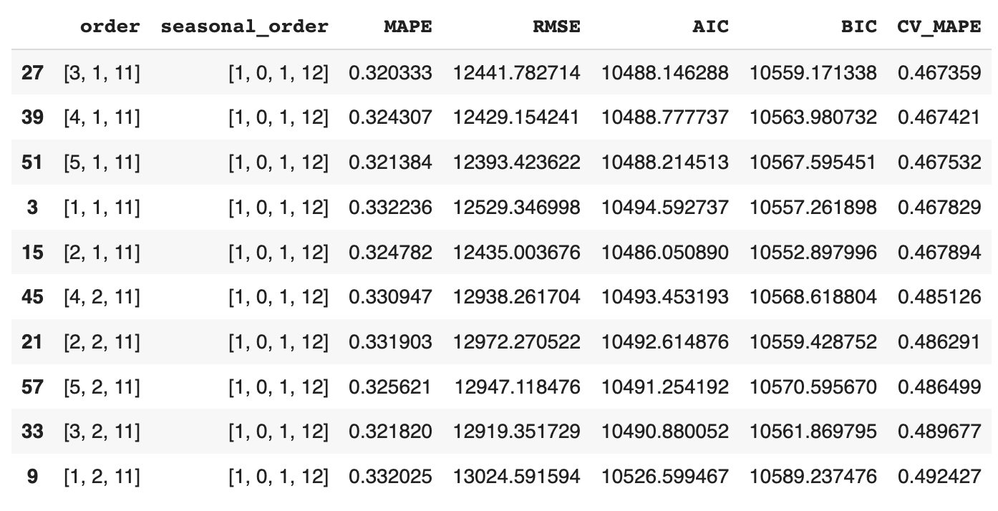
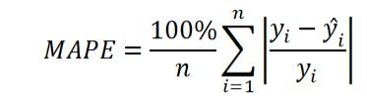
Modeling -SARIMAX
10 least MAPE models are selected and cross-validated. Ultimately, the results are shown in the table on the right.

Slide 12
Phase II
KMeans_cluster + Facebook Prophet/ Random Forest Regression

Slide 13
Data Processing
Check out missing data and outliers in Description column
Visualize time series
Data Diagnostics
Data Cleaning
Data Visualization
Sanitize Description
Vectorize Description
K-means Clustering
Interpolate()
IsolationForest()

Slide 14
Target Variable & Predictive Variable
Total_amount in sterling (Â£) per InvoiceDate/ transaction week is the target variable.
Direct Variable List:
InvoiceDate: Features of time are critical in the modeling because they capture seasonality
Derived Variable List:
const: constant dummies
trend, trend_squared, trend_cubed: time trends
s(2,7), s(3, 7) …: weekly seasonality
sin(23,freq=A-DEC), cos(23,freq=A-DEC) …: annual seasonality
Holiday: US national holidays. The holiday has an effect on people’s purchasing patterns.
clusters
When we have design ideas, we’ll show them to you right there.

Slide 15
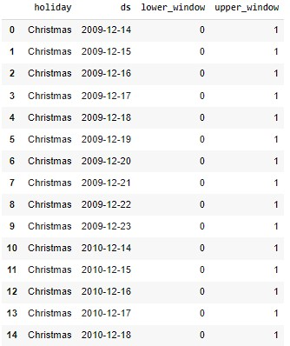
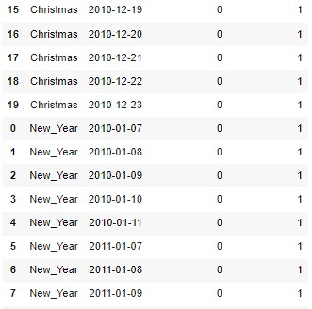
Pre-modeling (Facebook Prophet)

Slide 16
Pre-modeling (Random Forest Regression)
DeterministicProcess, CalendarFourier from statsmodels.tsa.deterministic
One-Hot encoding holiday features
Prophet.predict() from prophet
Data seasonality and trend analysis
Derived variable creation
Autocorrelation
Power Spectral Density
Seasonality decomposition

Slide 17
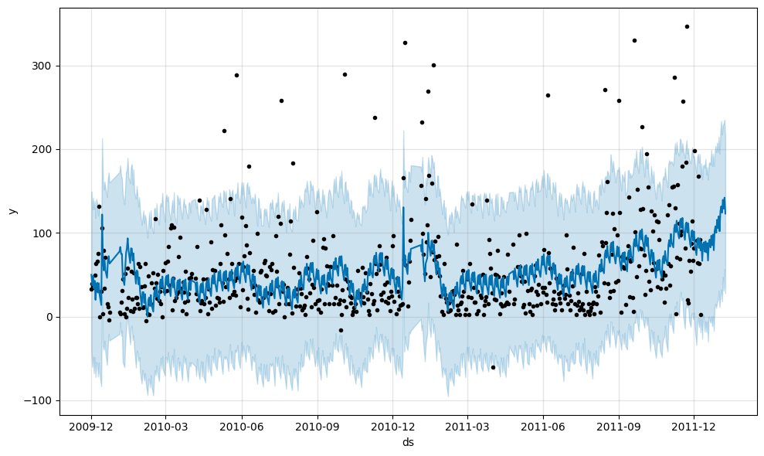

Modeling – Facebook Prophet

Slide 18
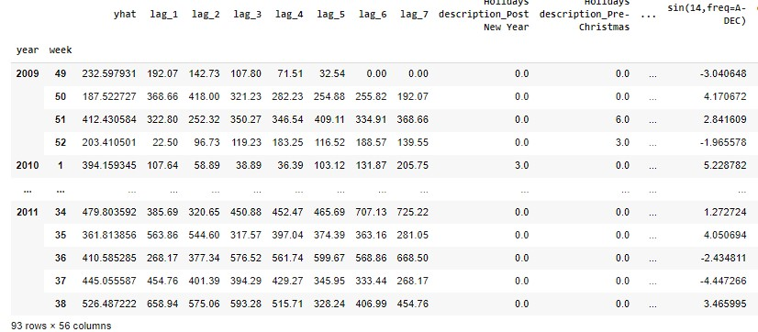

Modeling – Random Forest Regression
Screenshot of features

Slide 19
Phase Ⅲ
GPT-cluster+ Google Bard + XGBoost

Slide 20
Data Processing
Check out missing data and outliers in Description and Price column
Data Diagnostics
Data Cleaning
Sanitize Description
Drop off records with Price = 0
Merge two worksheets together

Slide 21
Target Variable & Predictive Variable
Total_amount in sterling (Â£) per transaction week is the target variable.
Direct Variable List:
InvoiceDate: Features of time are critical in the modeling because they capture seasonality
Derived Variable List:
const: constant dummies
lags: serial dependence
trend, trend_squared, trend_cubed: time trends
s(2,7), s(3, 7) …: weekly seasonality
sin(23,freq=A-DEC), cos(23,freq=A-DEC) …: annual seasonality
Holiday: US national holidays. The holiday has an effect on people’s purchasing patterns.
clusters
When we have design ideas, we’ll show them to you right there.

Slide 22

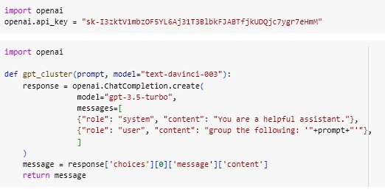
Pre-modeling – GPT-cluster

Slide 23
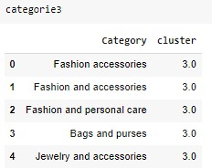
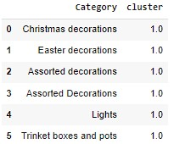

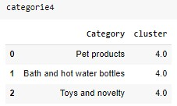
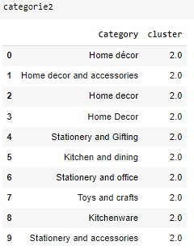
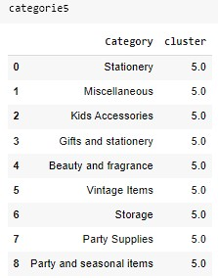
Pre-modeling– Google Bard further cluster

Slide 24

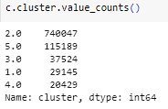
Pre-modeling –Semi-supervised classification

Slide 25
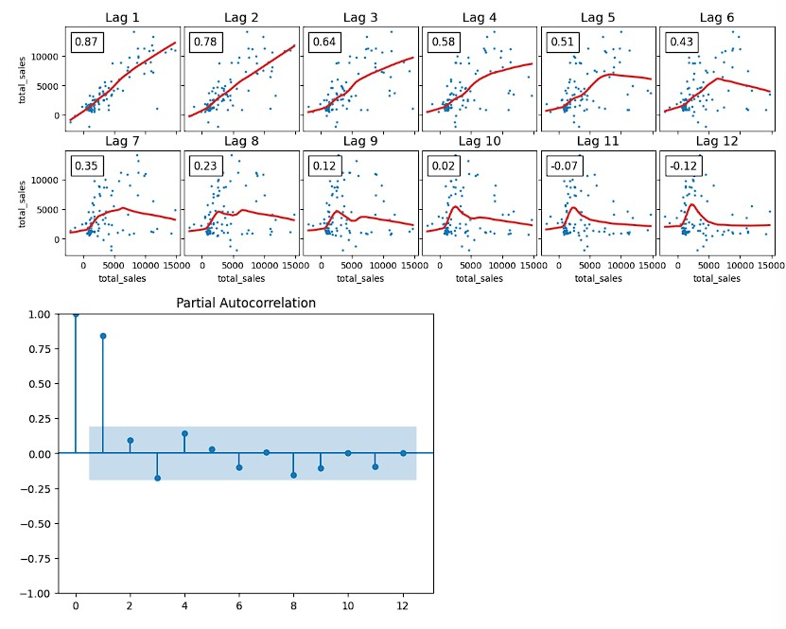
Pre-modeling
DeterministicProcess, CalendarFourier from statsmodels.tsa.deterministic
One-Hot encoding holiday features
plot_pacf from statsmodels.graphics.tsaplots
Data seasonality and trend analysis
Derived variable creation
Autocorrelation
Power Spectral Density
Seasonality decomposition

Slide 26
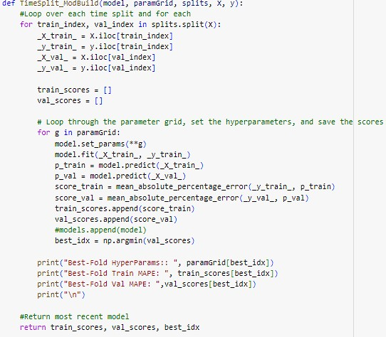

modeling

Slide 27

Next Step
Pipeline automation would be a research direction worthy of digging deeper into.
Another potential research direction is the trade-off between clusters’ explainability and the speed of getting reliable forecasting models.

Slide 28

One man gang
Yunpeng Wang

